Slide 1
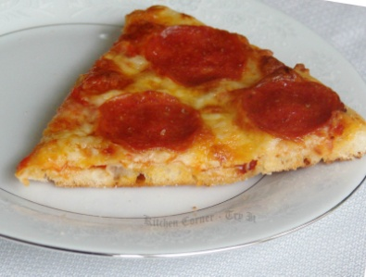
BPA FAMILY SPIRIT NIGHT
Tampa Pizza Co.
4110 Henderson Blvd.
Tampa, FL 33629
5:00-8:00 PM
Wednesday, March 10, 2021

